Slide 1

Modeling Scope 3 Greenhouse Gas Emissions using Corporate Financial Data
MSDS692 Data Practicum I
Cliff Hunt

Slide 2

Presentation Outline
Green House Gas Emissions Overview
Scope 3 GHG issues
CDP Data
Project Outline
APIs
Data Merging
Data Cleaning and Exploration
Data Modeling

Slide 3

The challenge of climate change and the role of businesses.
· Climate Change Threatens All: Climate change is happening at an ever-increasing rate and has potential consequences for economies, societies, and the environment.
· Businesses are Major Emitters: Corporations and businesses are significant contributors to greenhouse gas emissions through their operations and supply chains.
· Businesses Have Power to Act: Climate conscience businesses can play a role in reducing emissions and driving sustainable practices.
Climate Business | Business Climate. Harvard Business Review. (2007). https://hbr.org/2007/10/climate-business-_-business-climate
3
Notes:
Page 2 the urgency of climate change demands immediate action. Today, I want to explore the critical role businesses and corporations can play in tackling this global challenge.
· Climate Change Threatens All:
Climate change is not a distant threat. It's happening now, and its effects are already being felt around the world. Rising sea levels, extreme weather events, and disruptions to ecosystems threaten economies, societies, and the environment, creating a complex web of challenges that demand immediate action.
· Businesses are Major Emitters: While the products and services businesses offer are visible contributors to emissions, their true impact extends beyond the storefront. The operations and supply chains of corporations and businesses generate a significant share of global greenhouse gas emissions, demanding innovative solutions for a sustainable future.
· Businesses Have Power to Act: Climate-conscious businesses have the power to go beyond mere good intentions and become catalysts for meaningful change. By reducing emissions and driving sustainable practices throughout their operations and supply chains, businesses can significantly impact global efforts to combat climate change.

Slide 4

What are Greenhouse Gas (GHG) Emissions?
Heat Trappers: Greenhouse gases (GHGs) are gases in the atmosphere that trap heat from the sun. These gases naturally occur, but human activities have significantly increased their concentrations.
The Greenhouse Effect: Normally, heat from the sun warms the Earth's surface, and some escapes back into space. Greenhouse gases act like a blanket, absorbing some of this outgoing heat and radiating it back towards the planet, causing a warming effect.
Climate Change Drivers: The increased levels of greenhouse gases contribute to global warming and climate change, leading to rising temperatures, more extreme weather events, and rising sea levels.
https://climate.nasa.gov/climate_resources/240/the-greenhouse-effect-simplified/
4
Notes:
Page 3 What are Greenhouse Gas Emissions?
Heat Trappers: Greenhouse gases (GHGs) are atmospheric gases that absorb and retain heat from the sun, playing a critical role in regulating Earth's temperature. While these gases, such as carbon dioxide, methane, and nitrous oxide, occur naturally and are essential for maintaining life-supporting temperatures, human activities have drastically increased their levels. Industrial processes, deforestation, and the burning of fossil fuels have accelerated the concentration of these gases, intensifying the greenhouse effect and contributing significantly to global warming and climate change.
The Greenhouse Effect: Normally, heat from the sun warms the Earth's surface, and some escapes back into space. Greenhouse gases act like a blanket, absorbing some of this outgoing heat and radiating it back towards the planet, causing a warming effect.
Climate Change Drivers: The increased levels of greenhouse gases contribute to global warming and climate change, leading to rising temperatures, more extreme weather events, and rising sea levels.

Slide 5
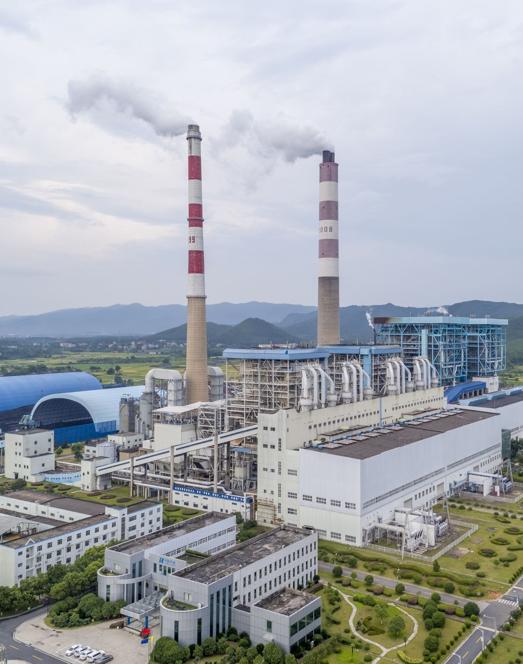
Demystifying Scopes: Scope 1, 2, and 3 Explained
Scope 1 emissions are greenhouse gas emissions that come directly from a company's activities and the sources they control. These emissions are easiest to track and often the most controllable for an organization.
Scope 2 Emissions: Indirect emissions from purchased electricity, heat, or steam. These emissions occur from external sources like power plants that supply an organization's energy needs. The amount is calculated using emission factors based on the energy source mix.
Casey, S. (2023, March 15). Scope 1,2,3 emissions – What is it? Mansfield Energy. Retrieved from https://mansfield.energy/2023/03/15/emissions-scope-123-what-is-it/
5
Notes:
Page 4 - Demystifying Scopes: Scope 1, 2, and 3 Explained
Scope 1 emissions refer to greenhouse gas emissions that are directly produced by a company through its own activities and from sources it controls. These emissions typically originate from on-site fuel combustion, such as natural gas burned in company-owned boilers, or the use of company-owned vehicles. Because they stem from operations that the company directly manages, Scope 1 emissions are generally the easiest to measure and track. For example, emissions from a manufacturing plant’s furnaces or a fleet of delivery trucks fall under Scope 1. Consequently, these emissions are often the most controllable for an organization, providing clear opportunities for reduction through efficiency improvements or the adoption of cleaner technologies.
Scope 2 emissions are indirect greenhouse gas emissions resulting from the consumption of purchased electricity, heat, or steam. Unlike Scope 1 emissions, these emissions are not directly produced by the organization itself but by the external facilities that generate the energy it uses.
For example, if a company purchases electricity from a local utility provider, the emissions produced by the power plant to generate that electricity are classified as Scope 2 emissions for the company. Similarly, if the company buys steam or heat for its operations, the emissions from the facility producing that steam or heat are included in its Scope 2 emissions.
To calculate Scope 2 emissions, organizations use emission factors that account for the energy source mix of the electricity they consume. This means considering the proportion of energy generated from fossil fuels (like coal, natural gas, and oil), renewable sources (like wind, solar, and hydro), and nuclear power. The more a company's energy supply relies on fossil fuels, the higher its Scope 2 emissions will be.
For instance, if a company sources its electricity from a grid that primarily uses coal-fired power plants, its Scope 2 emissions will be relatively high. Conversely, if the company switches to a supplier that provides electricity from renewable sources, such as wind or solar power, its Scope 2 emissions will significantly decrease.

Slide 6
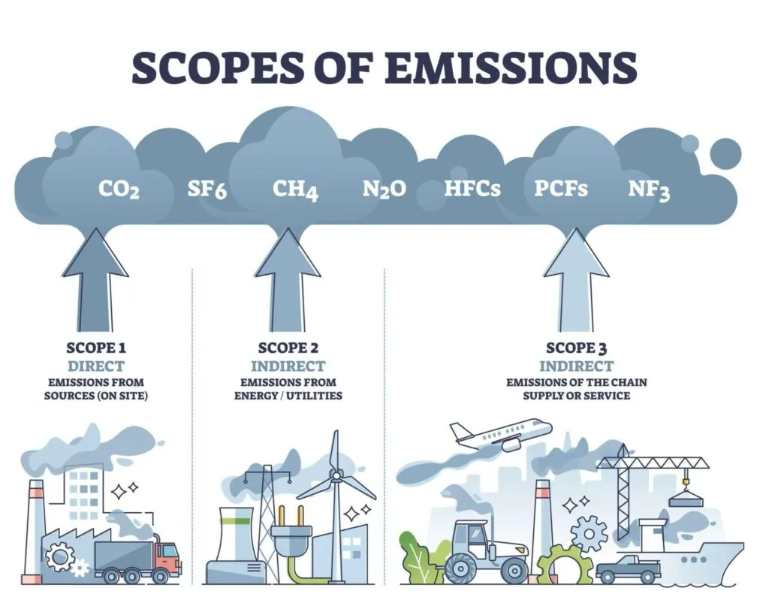
Focus on Scope 3: Indirect emissions from a company's value chain.
Scope 3 emissions
Most difficult emissions to measure in a company's carbon footprint
Indirect emissions that arise throughout the entire value chain
While difficult to control, they can be a major source of emissions
Casey, S. (2023, March 15). Scope 1,2,3 emissions – What is it? Mansfield Energy. Retrieved from https://mansfield.energy/2023/03/15/emissions-scope-123-what-is-it/
6
Notes:
Page 5 - Scope 3 emissions, also known as value chain emissions, represent all indirect greenhouse gas (GHG) emissions that occur in a company’s value chain, excluding those covered in Scope 2 (purchased electricity, heat, and steam). Unlike Scope 1 emissions, which are direct emissions from owned or controlled sources, and Scope 2 emissions, which are indirect emissions from the generation of purchased energy, Scope 3 emissions encompass a broad array of activities outside the direct operational control of the company.
The CDP data, which we will delve into shortly, details 17 distinct categories of Scope 3 emissions. Each category represents a unique source of indirect greenhouse gas emissions within a company's value chain, encompassing everything from purchased goods and services to waste generated in operations and end-of-life treatment of sold products. These categories are meticulously calculated and reported separately to provide a comprehensive picture of a company's total carbon footprint. Understanding and managing these diverse sources of emissions is crucial for developing effective climate strategies and achieving meaningful reductions in overall greenhouse gas emissions.

Slide 7
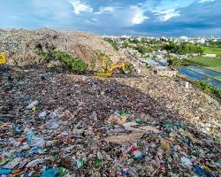

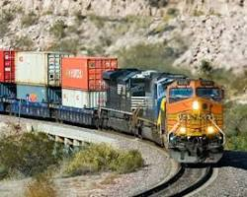
Scope 3 GHG emission examples: Purchased goods, employee commuting, product use, production of raw materials, transportation of goods, disposal of products, etc.
Emissions from the production of raw materials: This includes the emissions from mining, drilling, and other activities involved in extracting raw materials from the earth.
Emissions from the disposal of products: This includes the emissions from landfills and incinerators that dispose of a company's products.
Emissions from the transportation of goods:
This includes the emissions from trucks, trains, ships, and airplanes that transport goods to and from a company's facilities.
https://ghgprotocol.org/sites/default/files/2022-12/Chapter1.pdf
7
Notes:
Page 6
• Emissions from the Production of Raw Materials:
arise from activities such as mining, drilling, deforestation, and other extraction processes used to procure raw materials. They contribute significantly to a company's carbon footprint, as they often involve energy-intensive processes and often require heavy machinery powered by fossil fuels.
• Emissions from the Disposal of Products:
This category covers emissions generated during the disposal phase of a company's products, including those sent to landfills or incinerators. Landfills produce methane, a potent greenhouse gas, while incinerators release carbon dioxide and other pollutants.
• Emissions from the Transportation of Goods:
These emissions stem from the transportation of goods using trucks, trains, ships, and airplanes. The burning of fossil fuels in transportation contributes significantly to greenhouse gas emissions and air pollution.

Slide 8

Scope 3 GHG Use of Sold Products
Emissions from the use of sold products: This includes the emissions generated when a customer uses a company's product.
Aircraft Manufacturers: Emissions from the fuel combustion of airplanes sold to airlines.
Consumer Electronics: Energy use associated with operating electronic devices (e.g., smartphones, laptops) sold to consumers.
Food and Beverage Industry: Emissions from agricultural products sold to consumers, including methane emissions from livestock.
8
Notes:
Page 7
Emissions from the use of sold products: This includes the emissions generated when a customer uses a company's product.
An example would be a company that manufactures airplanes. The emissions from the airplanes themselves wouldn't be part of the company's Scope 1 or 2 emissions (since they don't directly control the airplanes once sold). However, the fuel burned by the airplanes during flight would contribute to the company's Scope 3 emissions. This is because the airplane's use, a consequence of being sold, directly generates greenhouse gas emissions.

Slide 9

Scope 3 GHG Emissions: Measuring and Reporting Difficulties
Lack of Standardized Methodology: Currently, there's no single, universally accepted methodology for measuring Scope 3 emissions.
Data Availability and Quality: Reliable data on emissions throughout the value chain is often scarce.
Complexity of Supply Chains: Modern supply chains are intricate, with multiple tiers of suppliers and geographically dispersed operations.
Resource Constraints: Smaller companies, with limited budgets and personnel, often struggle to allocate resources for comprehensive Scope 3 measurement and reporting.
Greenwashing Concerns: Companies with less rigorous methods might underestimate their true emissions footprint, leading to accusations of greenwashing.
Deloitte. (2023, December 22). Challenges and solutions in measuring and reporting Scope 3 emissions. https://www2.deloitte.com/nl/nl/pages/sustainability/articles/challenges-and-solutions-scope-3-emissions.html
9
Notes:
Page 8
Scope 3 GHG Emissions: Measuring and Reporting Difficulties
• Lack of Standardized Methodology: There’s No universally accepted methodology that exists for measuring Scope 3 emissions, and this leads to varied approaches and comparability challenges.
• Data Availability and Quality: Reliable emission data throughout the supply chain is often scarce, hindering accurate measurement and reporting.
• Complexity of Supply Chains: Modern supply chains are intricate and global, involving multiple tiers of suppliers and operations, complicating Scope 3 emissions tracking.
• Resource Constraints: Small companies face challenges in allocating sufficient resources for comprehensive Scope 3 measurement, often due to limited budgets and personnel

Slide 10
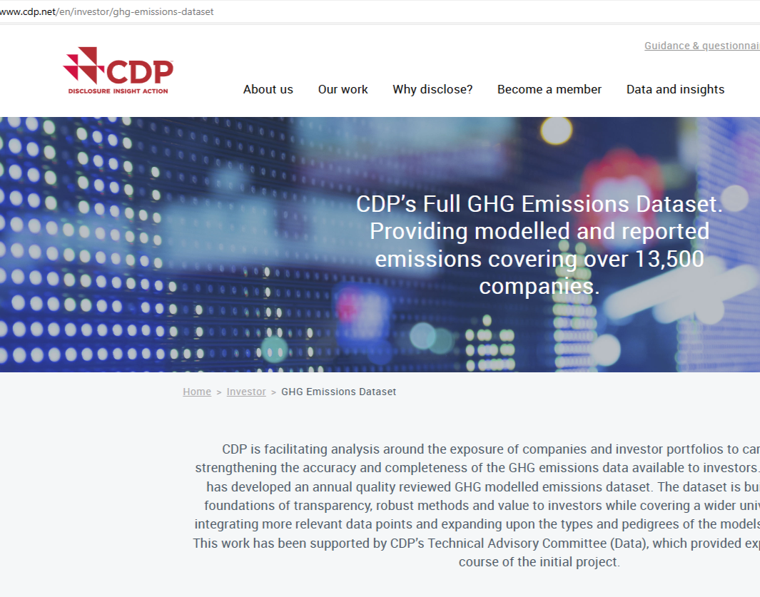
Data Source: CDP GHG Emissions Datasets 2013-2023
The CDP was established as the ‘Carbon Disclosure Project’ in 2000, asking companies to disclose their climate impact.
CDP is a not-for-profit charity that runs the global disclosure system for investors, companies, cities, states and regions to manage their environmental impacts.
https://www.cdp.net/en/info/about-us
10
Notes:
Page 9
One of the major sources of data for this project was the CDP datasheets encompassing the years 2013-2023 which provides comprehensive data on corporate environmental performance
CDP was established as the ‘Carbon Disclosure Project’ in 2000, the CDP initially focused on urging companies to disclose their climate impacts, evolving into a broader initiative over time.
As a not-for-profit charity, CDP operates a global disclosure system. It enables investors, companies, cities, states, and regions to effectively manage and mitigate their environmental impacts through transparency and accountability measures.

Slide 11

CDP Dataset Issues
The goal was to merge all years of data together
Data had different formats in different years
No distinction between public and private companies
Stock tickers for foreign exchanges not standardized
17 different types of Scope 3 emissions
Null values and incorrect values (outliers)
Third Party Validation data formatted differently
11
Notes:
Page 10
Even though the CDP dataset come neatly organized in separate Excel workbooks for each year they still require a great deal of data wrangling to extract the needed data.
The goal was to merge all years of data together but different of data had different formats, there was not distinction between public and private companies, and there were many incorrect and null values.

Slide 12

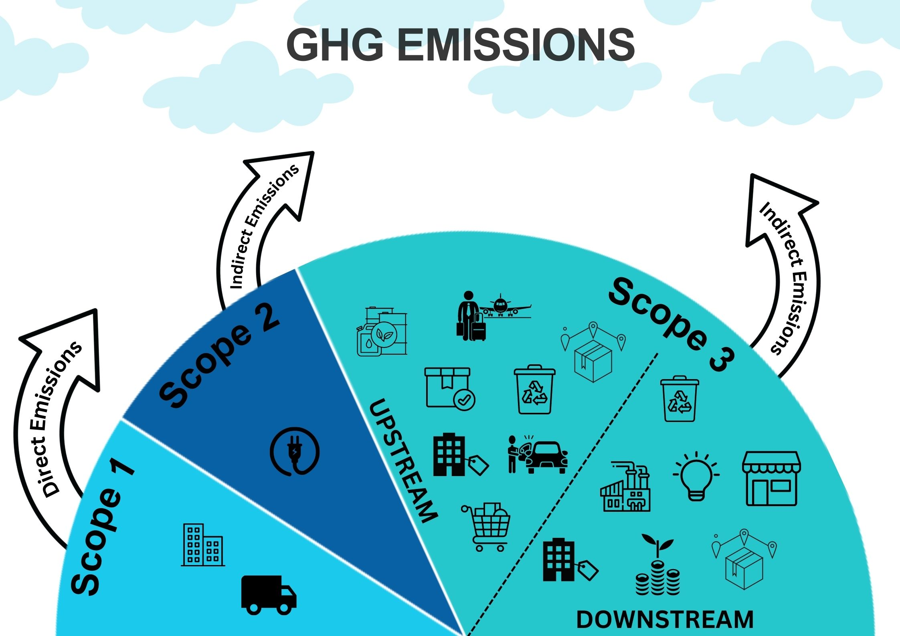
A novel approach: Using corporate financial statements as a proxy.
Rationale: Financial data reflects a company’s activities and could reflect their carbon footprint.
Potential benefits: Enabling cost-effective Scope 3 estimation
12
Notes:
Page 11
• Project Approach: This project aims to delve into the utilization of corporate financial data as a tool to model Scope 3 emissions across diverse organizations. By analyzing financial metrics alongside emissions data, it seeks to uncover correlations that highlight how financial activities can mirror and influence carbon footprints.
• Rationale for Approach: The underlying rationale is grounded in the premise that a company's financial performance and operational activities are intricately linked to its environmental impact. Financial data, such as revenue, profit, debt, and investments could potentially provide indirect but significant indicators of Scope 3 emissions.
• Potential Benefits: Adopting financial data for Scope 3 emissions modeling offers several potential benefits and advantages. It presents a cost-effective method to estimate emissions for a wide spectrum of organizations, leveraging existing financial reporting frameworks. This approach not only enhances environmental transparency but also facilitates informed decision-making for sustainability strategies, aligning financial and environmental goals more closely.

Slide 13
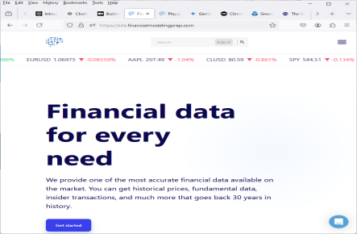
Data Practicum Project Outline
CDP Datasets
2013-2023
Format all tickers/exchanges
Pull all Scope 3 data
Pull all 3rd Party Validation data
Stock Ticker List
API to retrieve 10 years of income and financial statements
https://site.financialmodelingprep.com/
2013 Financial & Scope 3 data
Merge all Scope 3 and financial data
2013
2023
2013
2013
2013
Data Cleaning
Data Modeling
13
Notes:
The project as I have worked through it has involved 6 distinct steps
The initial step involved extracting stock ticker symbols from the CDP dataset, a process complicated by inconsistencies in format and location across years of data and stocks for over 40 foreign stock exchanges.
Next APIs were developed to retrieve historical financial data (income statements, employee counts, etc.) for the identified companies from financialmodelingprep.com, extending back to 2013.
The next step was to pull extract the scope 3 data from the CDP dataset. This again dealt with various formats over the years and included 17 different types of scope 3 emissions.
Next was to pull the third party verification data from the CDP data to investigate if it could correlate with reported emissions.
Once all the data was pulled from the individual CDP year datasets the next challenge was to merge all that data into one comprehensive dataframe for subsequent modeling.
Next the merged dataframe underwent cleaning and explored to identify patterns and correlations.
Lastly, models can be developed and evaluated for accuracy.

Slide 14

Building a historical record: Gathering 2013-2023 reported corporate data.
Domestic Exchanges used regular stock ticker
Separate API functions needed to get 11 years of:
Market Cap
Employee Counts
Income Statements (EBITDA, Revenue, Profit, Net Income, Currency Used)
Balance Sheet Statements (Assets, Long/ShortTerm Debt, Cash, Liabilities, etc)
When ticker not available Separate API needed to search by:
ISIN (12-digit code that uniquely identifies a specific securities issue)
CUSIP number (unique nine-digit identification number assigned to financial securities in the United States and Canada)
For foreign stock tickers a dictionary was created to handle 40 different exchange formats.
14
Notes:
Page 13
Domestic Exchanges used regular stock ticker
To obtain a comprehensive picture of a company's financial health, we needed to gather various data points over an 11-year period. This included market capitalization, employee headcount, income statements (EBITDA, revenue, profit, net income, and currency used), and balance sheet statements (assets, long- and short-term debt, cash, liabilities,
etc.).
To automate data collection and ensure consistency, separate API functions were developed to retrieve the financial metrics mentioned above. This streamlined the process and reduced the potential for errors.
In cases where standard tickers were unavailable, the system employed alternative identifiers like the 12-digit ISIN (International Securities Identification Number) and the 9-digit CUSIP number (Committee on Uniform Securities Identification Procedures number) used primarily in North America.
To handle the complexities of data formats from over 40 foreign exchanges, a custom dictionary was created. This dictionary mapped exchange-specific identifiers to the financial data points we needed.

Slide 15
First Step: Create stock ticker list from CDP data
Format all tickers/exchanges
Most of the sheets have a Summary worksheet but with varying formats for different years
program_name | account_id | account_name | region | incorporated_country | Access | GRI | secondary_expansion | ticker
Climate Change | 44 | 3i Group | United Kingdom | United Kingdom | Public | Banks, Diverse Financials, Insurance | FTSE 600,FTSE 725,FTSE 350 | III LN
Supply Chain | 45 | 7COMM INFORMATICA LTDA | South America | Brazil | Public | Software & Services | N/A
Climate Change | 53 | Abertis Infraestructuras | Southern Europe | Spain | Public | Ground Transportation - Highways & Railtracks | FTSE All-World,Euro,Iberia,Spain | ABE SM
Supply Chain | 55 | Amway Corporation | USA | USA | Public | Consumer Durables, Household and Personal Products | N/A
Supply Chain | 58 | ABM INDUSTRIES INC | USA | USA | Public | Trading Companies & Distributors and Commercial Services & Supplies | N/A | ABM US
Climate Change | 64 | Abbott Laboratories | USA | USA | Public | Healthcare Providers & Services, and Healthcare Technology | FTSE All-World,Global 500,Bonds,S&P 500,Russell 1000 | ABT US
Climate Change | 78 | Aberdeen Asset Management | United Kingdom | United Kingdom | Public | Banks, Diverse Financials, Insurance | FTSE 600,FTSE 100,FTSE 725,FTSE 350 | ADN LN
The stock tickers come in various formats with the codes for the various international exchanges
III LN = III.L
ABE SM = ABE.MC
ABM US = ABM
The stock tickers come in various formats with the codes for the various international exchanges
Once converted the tickers are fed into the API to retrieve the corporate financial data
15
Notes:
The first step involved creating a stock ticker list from the CDP data sheet. While most sheets included a summary sheet to work from, the code needed to accommodate the various formats it might encounter. Foreign tickers then had to be converted into the correct symbols based on the country of the exchange where they were traded.

Slide 16
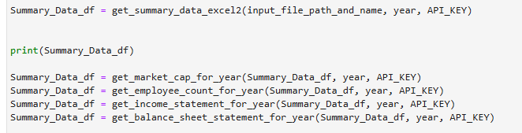
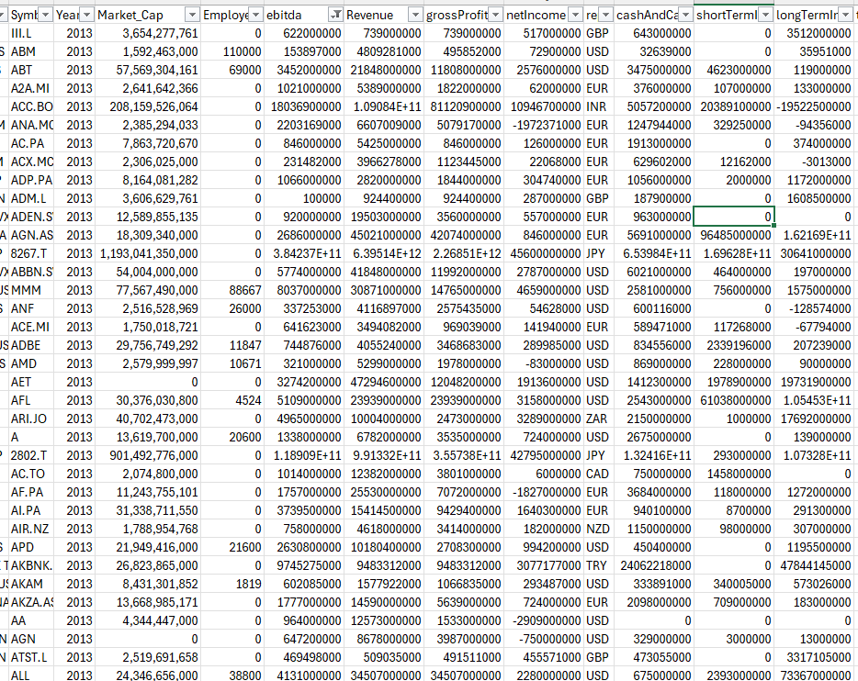
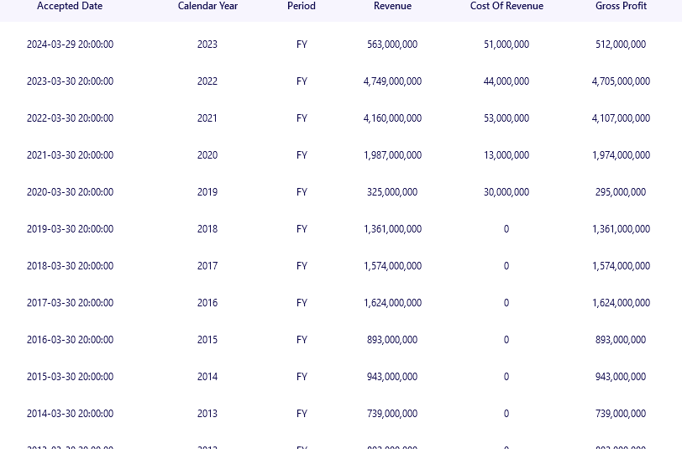
Create custom APIs to retrieve financial data
API to retrieve 10 years of income and financial statements
III.L
FinancialModelingPrep.com Via API
Financials retrieved: Reported Currency, Employee Count, Revenue, EBITDA, Market Cap, gross Profit, Net Income, Cash&Cash Equivalents, Short/Long Term Investments, Total Assets, Total Liabilities, Total Investments, Total Debt, Total Equity for 2013-2023
16
Notes:
Page 15
The properly formatted stock ticker list is then integrated into the API code that queries the website for historical corporate data. While the website provides example code for building APIs to parse their data, it serves mainly as a starting point. Enhancements were made to this code to allow parsing through a list and storing the retrieved JSON files into a dataframe. Additionally, a 'fixed window' method was implemented to limit the number of API calls to 300 per minute, ensuring compliance with the specified query limit.

Slide 17
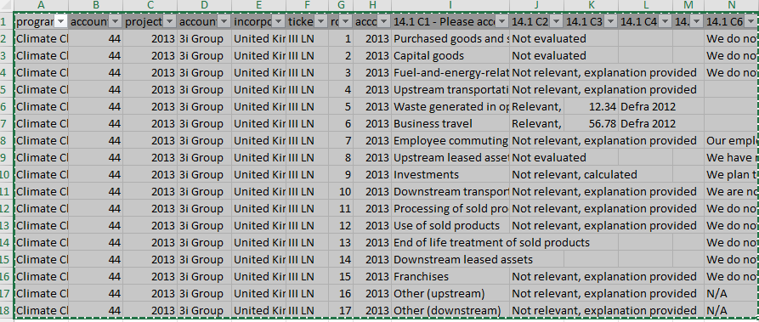

Combine all CDP and financial data into uniform dataframes
Pull all Scope 3 data
Pull all 3rd Party Validation data
CDP data issues:
-Different worksheets
-Different headers
-Different Ticker formats
-Missing Industry, Sector information
-Incorporate 3rd Party Verification
-Incorporate Evaluation Status
17
Notes:
Page 16
Following the retrieval of each year's financial data, the scope 3 data had to be extracted from a different section of the CDP report. The challenge here was the variation in report formats across different years, including differences in worksheet names and headers. Earlier reports lacked industry and sector data, so I created an industry/sector dictionary from later years to backfill the account IDs for the earlier years. Additionally, third-party verification status information was also extracted at this stage.

Slide 18
Merge all data by year into one cohesive dataframe
2013
2014
2015
2013, 2014, 2015, 2016, 2017, 2018, 2019, 2020, 2021, 2022, 2023
Merge all Scope 3 and financial data
2016
2017
2018
2019
2020
2021
2022
2023
Drop unneeded columns, add needed columns
Convert 40+ currencies to USD
Make data types uniform
Fully merged raw data= 914,373 rows x 42 columns
18
Notes:
Page 17
After the all the year extractions are complete they were then merged into one comprehensive dataframe. Unnecessary columns were dropped, and data types were standardized. The financial data for foreign exchanges is initially retrieved in the respective local currencies. To address this, a dictionary storing exchange rates for approximately 40 currencies was created, enabling the conversion of these financial values into US dollars for subsequent modeling. This consolidated dataframe now encompasses over 914,000 rows of data.

Slide 19

Data Cleaning and EDA
Data Cleaning
-Drop emissions amounts with no data
-Deal with nulls
-Drop rows where all corporate data = 0
-Replace categorical data with numeric
-Find correlation
-Deal with outliers…
19
Notes:
Page 18
The next step is the data cleaning process. Many companies reported only two or three types of scope 3 emissions, resulting in numerous null values that needed to be addressed. Dropping these brought the total dataframe size to around 156K rows. Rows lacking complete corporate data were dropped, as these were either from private companies or not included in the financial information database. Dropping these rows brought the dataframe size to just over 104K rows. Additionally, categorical data was converted into numeric values to facilitate inclusion in a heatmap.

Slide 20
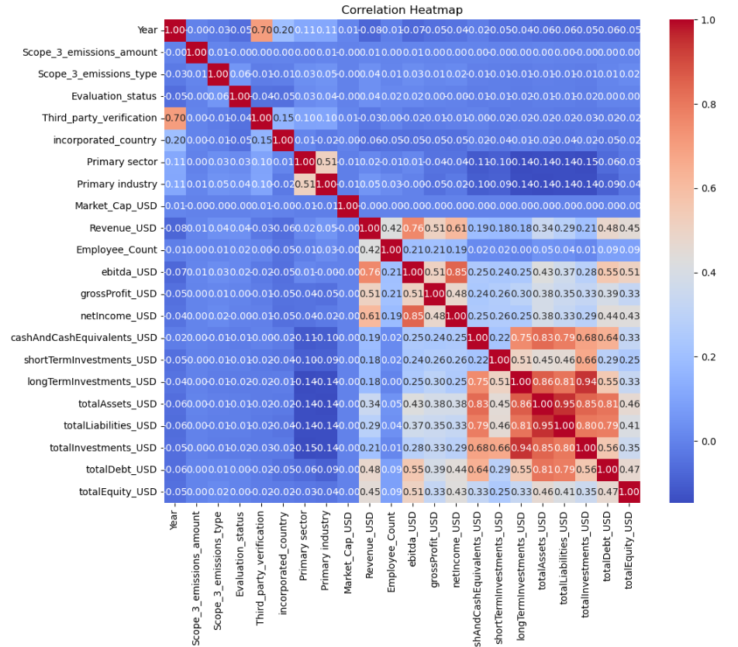
Analyzing Column Correlations: Identifying Interdependencies and Strengths
The heatmap shows strong correlation between the income statement values
It also shows strong correlation between the financial statement values
At this point very low correlation is seen between Scope 3 emissions amount and any other features
20
Notes:
Page 19
At this stage, a heat map was generated to preliminarily identify any correlations between scope 3 emissions and other features in the dataset. The heat map revealed two distinct clusters: one in the middle and another in the bottom right corner, which represent correlations within the financial data. This is expected, as increases in revenue often correspond with increases in gross profit. However, no strong correlations between scope 3 emissions and any other categories were observed at this point.

Slide 21
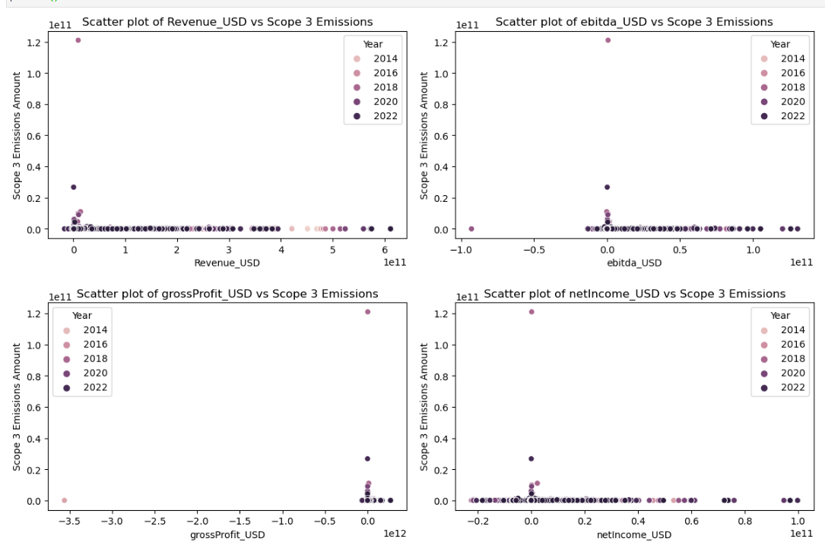
Outliers: Phase I
Use scatter plots to visually find outliers
-Plotting Scope 3 emissions vs. financial data shows most egregious outliers in both the Scope 3 data and the corporate financial data
-Filter those rows from the dataframe using specific account ID and year
21
Notes:
Page 20
At this point, we can begin plotting outliers to understand how tightly grouped the data is. In the initial phase, simple scatter plots were used to visualize these outliers. These plots compared various financial data against scope 3 emissions amounts, revealing several significant outliers in both categories. Going back and checking the data on these individual points revealed that most were clearly errors. Having 11 years of data proved helpful as it gave an idea of the normal distribution of the emissions and financial data. The outliers found at this point were orders of magnitude larger than the rest of the years data suggesting they were errors. The strategy was straightforward: to remove these outliers, they were filtered out by account ID and year. By identifying and excluding these outliers, we aim to prevent skewed results that could mislead our interpretations and conclusions.

Slide 22
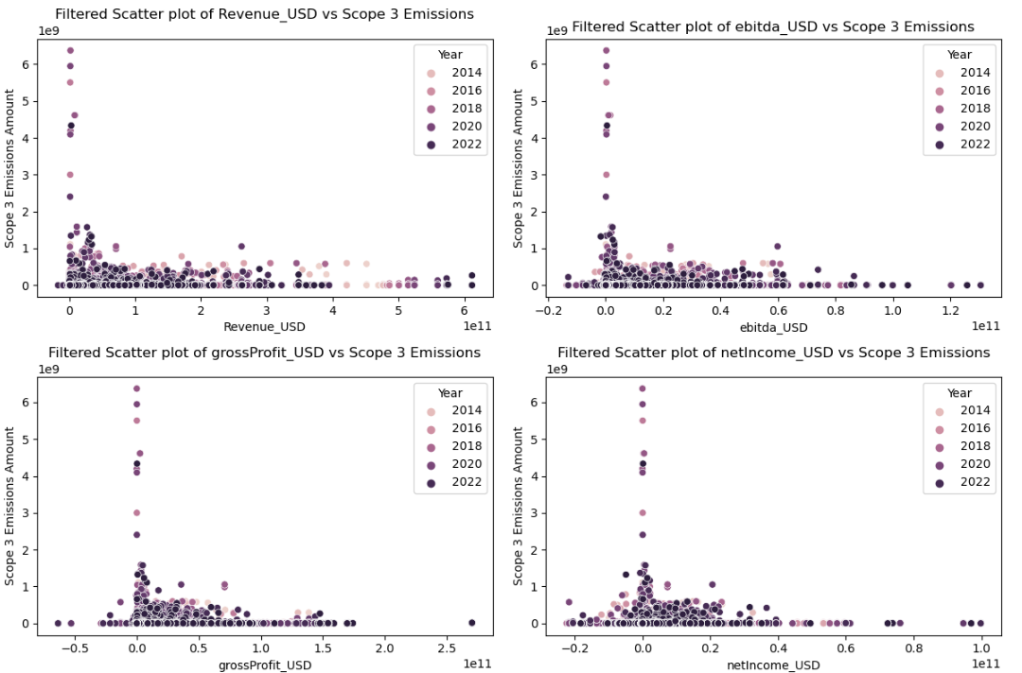
Outliers: Phase II
This improved the plots slightly but attempts to normalize the data still showed significant outliers
Next step:
-Calculate the Z-score of all Scope 3 and financial data, drop rows with Z-scores greater than or equal to 3
22
Notes:
Page 21
The subsequent plotting showed some improvement in the outliers, but attempts to normalize the data still revealed significant outliers. Upon further inspection, the underlying data included values well outside the normal ranges for both emissions and financial data. In the next round of outlier filtering, z-scores were calculated for the emissions and financial data, and any rows with z-scores of 3 or more were filtered out. This process reduced the size of the dataframe from 104,000 to 98,000 rows, effectively eliminating all significant outliers.
Additionally, this approach ensures a more robust dataset for further analysis by focusing on data within a reasonable range of variability. By removing extreme values, we can enhance the reliability and validity of our statistical analyses and predictive models, potentially leading to more accurate and insightful results.

Slide 23
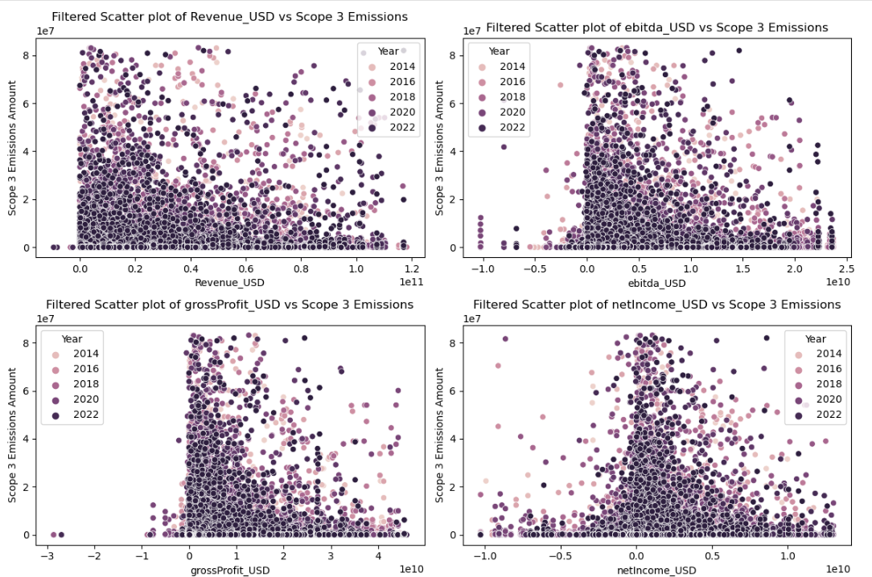
Outliers:
Eliminating high Z-scores gets rid of outliers however no discernible relationship is seen.
There were some efforts at feature engineer at this point
-Scope3 amounts/Revenue
-All features/Revenue
-totalLiabilities/Assets
But those produced strange results so did not pursue the idea further.
23
Notes:
Page 22
Having eliminated the high z-score outliers, the scatter plots now depict the bulk of the remaining data. However, these plots do not reveal any discernible patterns or relationships. At this point, I explored several feature engineering possibilities:
Scope 3 emissions divided by revenue
All features divided by revenue
Total liabilities divided by assets
These attempts aimed to normalize the data to account for the varying sizes of the companies, as larger companies naturally tend to have larger carbon footprints. Although these efforts did not produce immediately usable results, they are worth further exploration in future work. Normalizing data in this manner could potentially uncover hidden patterns and relationships, offering deeper insights into the factors influencing scope 3 emissions.

Slide 24
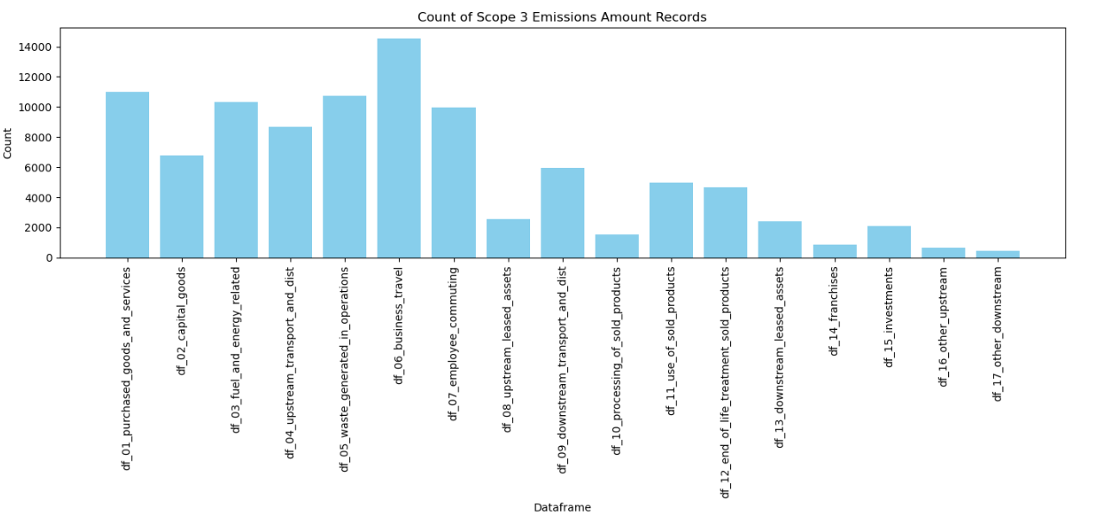
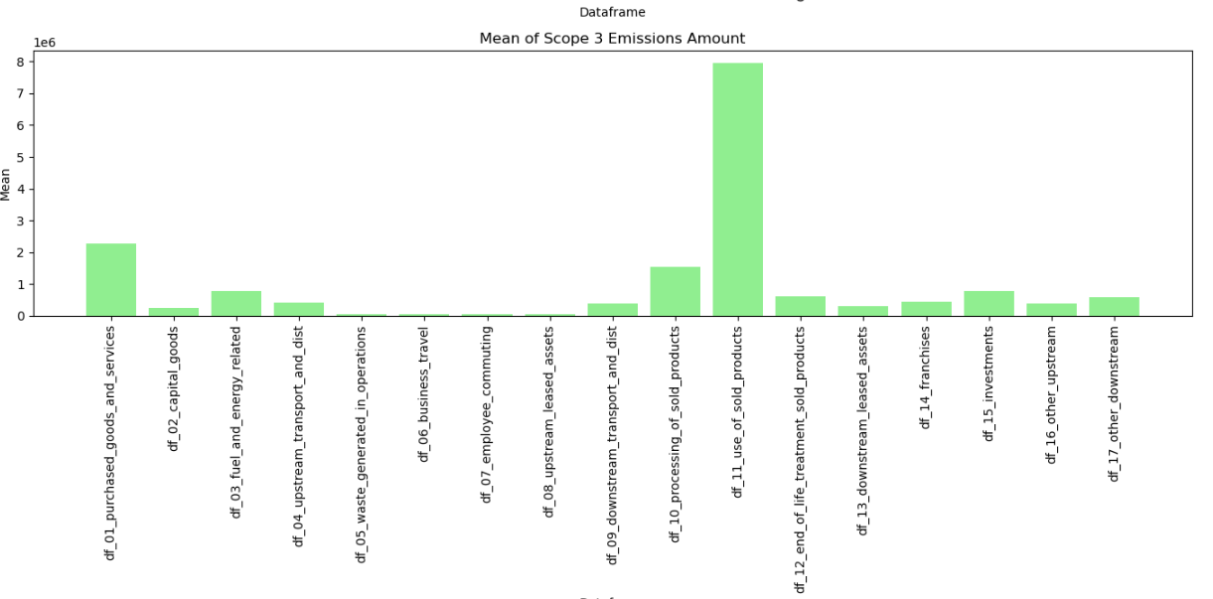
Exploratory Data Analysis continued
The 17 different types of Scope 3 data show varying numbers of records for each type
As well as varying Means for the Scope 3 emissions reported for each type
24
Notes:
Further exploratory analysis reveals considerable variation in the counts of the 17 different types of scope 3 emissions. The means of each type also vary significantly, with the highest being in the "Use of Sold Products" category.
This variability suggests that certain categories of scope 3 emissions are more commonly reported or more significant across companies. Understanding the reasons behind these variations could provide valuable insights into industry practices and highlight areas where companies could focus their sustainability efforts. Additionally, the prominence of the "Use of Sold Products" category indicates its critical impact on overall emissions, warranting further investigation into how products' lifecycle usage contributes to a company's carbon footprint.

Slide 25
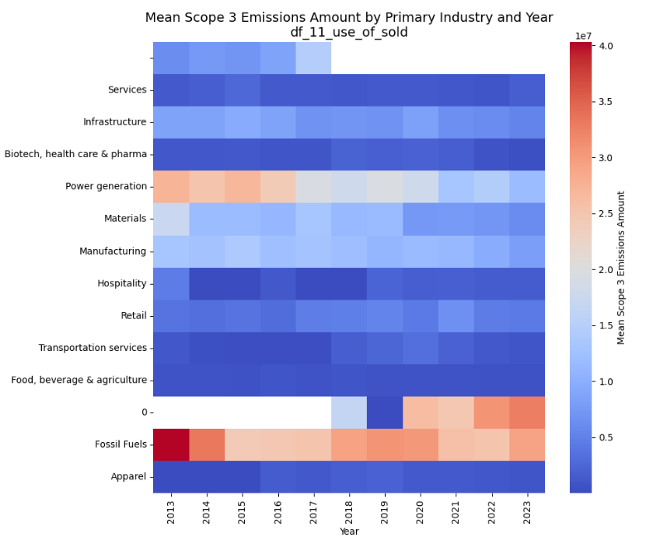
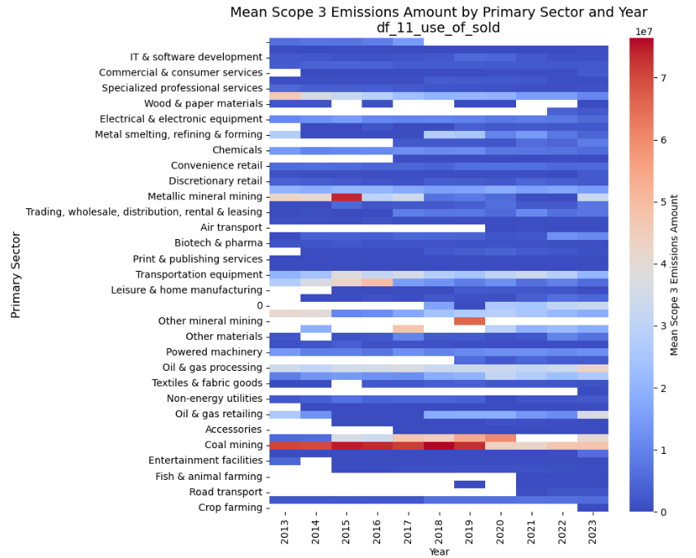
Industry and Sector Scope 3 breakdowns by year
25
25
Notes:
Page 24
We can also utilize a heatmap to illustrate the variation in scope 3 emissions across industries and sectors over time. Seventeen heatmaps were generated, each representing one type of scope 3 emission. The heatmap for the "Use of Sold Products" category, for instance, vividly shows that the highest reported emissions were in the Fossil Fuels industry, with Coal Mining being the leading sector. This pattern is logical since coal, the sold product, is converted into scope 3 emissions by consumers. These heatmaps not only highlight the significant contributors to emissions but also provide a visual tool for identifying trends and prioritizing areas for emissions reduction efforts.

Slide 26
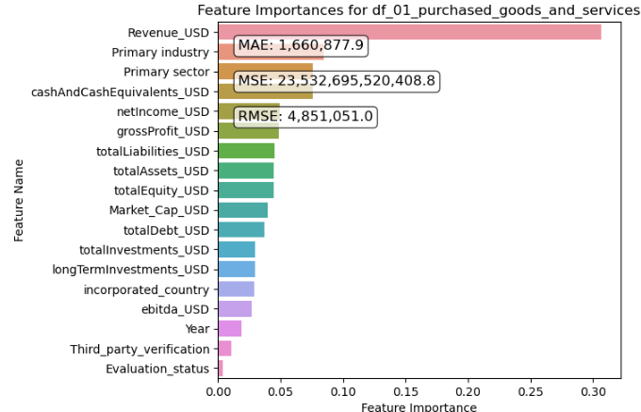
StandardScaler numerical processing with RandomForestRegressor modeling
StandardScaler, which scales the data based on the mean and standard deviation, can be sensitive to outliers since extreme values can significantly affect the mean and standard deviation.
RandomForestRegressor is a "meta estimator," which means that it combines the predictions of many individual models, called decision trees, to make a final prediction.
26
Notes:
Now, onto the actual modeling phase of the project. Here, we present the results of modeling the 'Purchased Goods and Services' category of emissions data using a standard scaler for numerical processing and a RandomForestRegressor model.
A RandomForestRegressor model is a good starting choice as it combines multiple decision trees to reduce overfitting and increase predictive accuracy. It can also handle missing values and work effectively with both numerical and categorical data.
Additionally, the RandomForestRegressor estimates feature importance, as shown in the horizontal bar plots. According to the plot, the most important feature in this data is the Revenue column.
We can measure the accuracy of the model using MAE (Mean Absolute Error), MSE (Mean Squared Error), and RMSE (Root Mean Squared Error). In this case, MAE is likely the best measure of accuracy as it is most resistant to outliers. Moreover, MAE is expressed in the units of the target variable, which, in this case, is metric tons of CO2, making it easier to understand. Here an MAE score of 1.657 million tons of CO2.

Slide 27
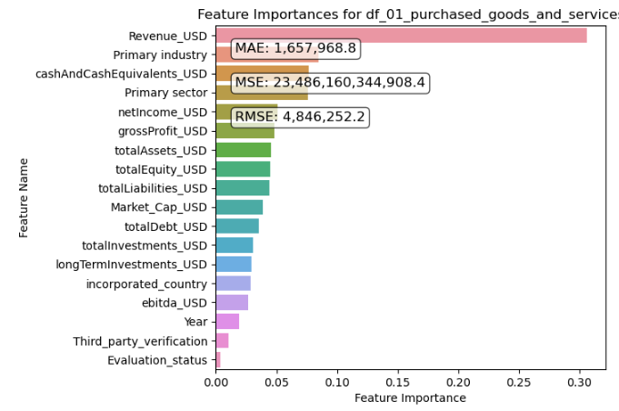
RobustScaler numerical transform with RandomForestRegressor modeling.
By using RobustScaler, the influence of extreme values in the data is reduced, which can help the RandomForestRegressor model to focus more on many of the data points and make more accurate predictions.
Brownlee, J. (2020, August 28). How to Scale Data With Outliers for Machine Learning. Retrieved from https://machinelearningmastery.com/robust-scaler-transforms-for-machine-learning/
Here the MAE difference is small which is probably due the z-score filtering accomplished during the data cleaning phase.
27
Notes:
Next, we apply the same RandomForestRegressor model but this time using a RobustScaler to assess whether it improves the model's accuracy. The RobustScaler is designed to scale the input to the model in a manner that makes it more resilient to outliers.
Interestingly, we observe a slight drop in the MAE score, indicating improved performance. However, upon reflection, the rigorous z-score filtering likely mitigated the impact of outliers, potentially rendering this type of scaling unnecessary. This insight suggests the importance of considering preprocessing steps in relation to the specific characteristics of the dataset and the applied model.

Slide 28
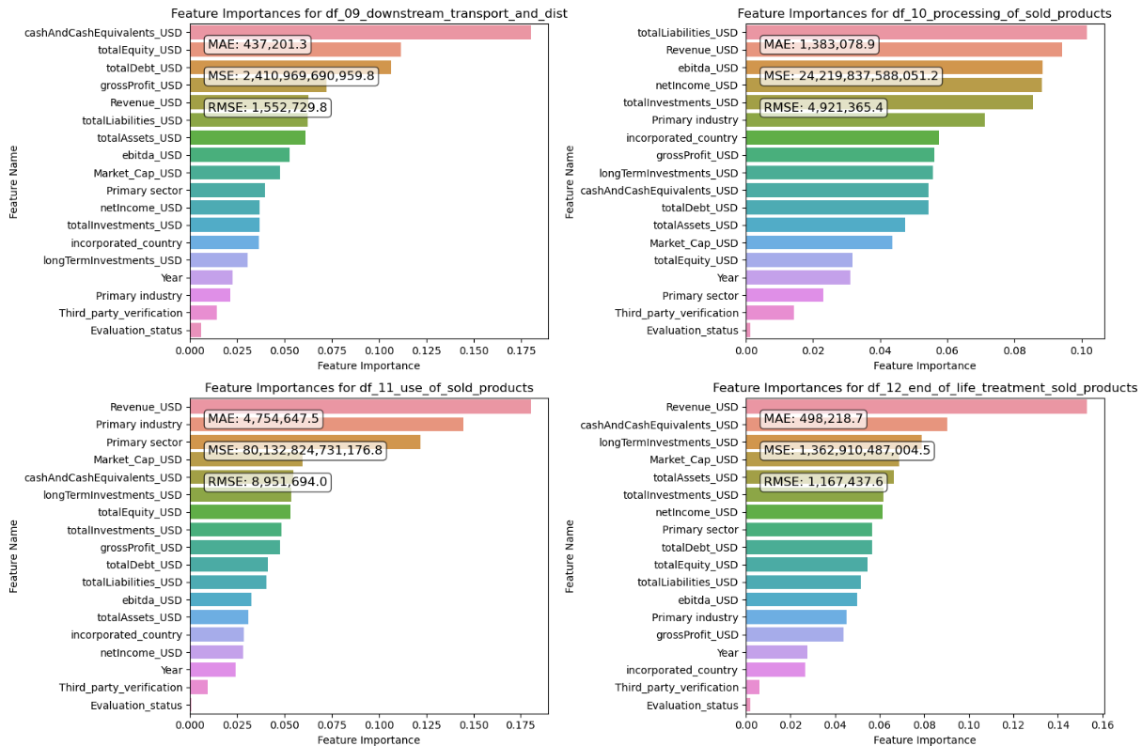
RobustScaler numerical transform with RandomForestRegressor modeling.
Feature importance values were different each of the 17 models
Revenue was the most important feature for 8 of the 17 models
28
Notes:
Next, we apply the RobustScaler with the RandomForestRegressor again, but this time, we analyze the feature values for four different types of emissions data. Interestingly, the most important features vary across the different model predictions.
For these four types, the top influential features include Cash and Cash Equivalents, Total Liabilities, and Revenue. Notably, Revenue emerged as the most critical feature in 8 out of the 17 models. This variation highlights how different aspects of financial data can influence emissions predictions, providing valuable insights into the complex relationships between a company's financial health and its environmental impact.

Slide 29
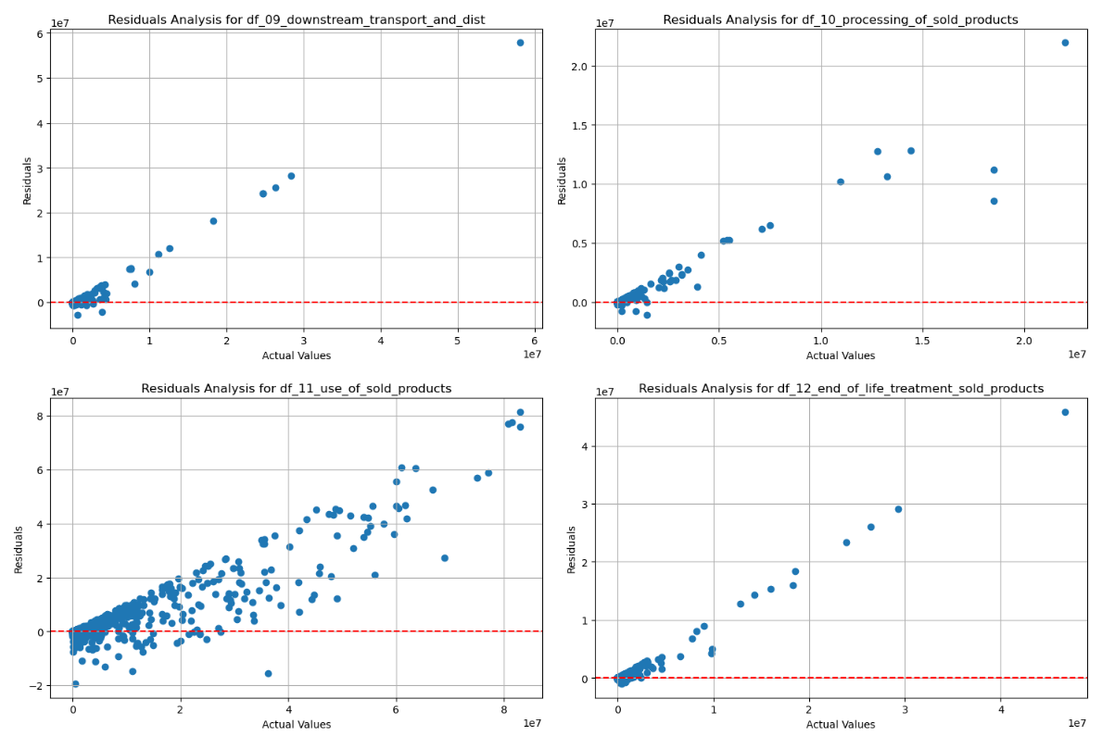
Understanding Model Performance: Residual Analysis
The model is considered a good fit if the residuals are randomly distributed. If there are patterns in the residuals, then the model is not accurately capturing the relationship between the variables
The linear shape in the residual plots indicate that it is not a good fit especially in the higher values
Notes:
Another way to gauge model accuracy is through residual analysis. These residual plots correspond to the preceding bar plots. A model is considered a good fit if the residuals are randomly distributed. However, if patterns are observed in the residuals, it suggests that the model is not accurately capturing the relationship between the variables.
In this case, the linear pattern in the residual plots, especially at higher values, indicates that the model is not a good fit. This pattern suggests that the model may struggle to accurately predict the data at these higher ranges, highlighting areas for potential improvement in the modeling approach.

Slide 30
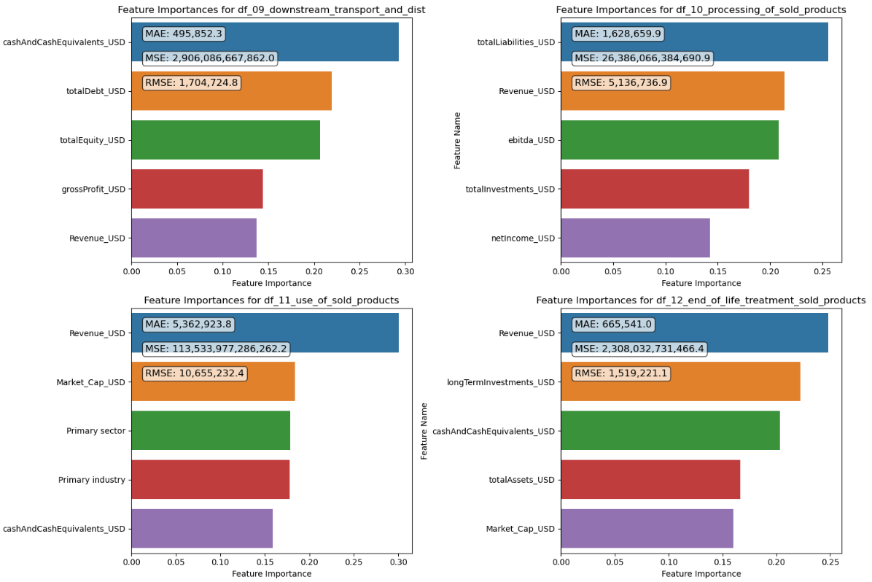
Robust Scaler with RFR-Reduced Features
Here the same four models are replicated but with only the top 5 features of each.
Note that the MAE value goes up, but the resulting models are more resistant to overfitting.
30
Notes:
One potential method to enhance model accuracy and prevent overfitting is by reducing the number of features, focusing only on the most influential ones. Below are the same four models, but this time only the top five most important features are considered.
Interestingly, while the MAE values have increased, indicating a drop in accuracy, using fewer features might lead to better performance on unseen data. This streamlined approach can help the model generalize more effectively, ultimately providing more reliable predictions when applied to new datasets.

Slide 31
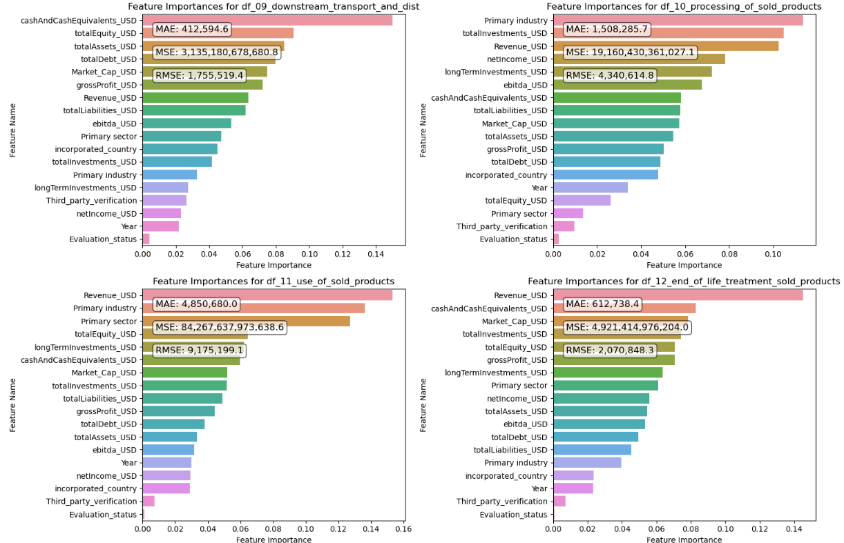
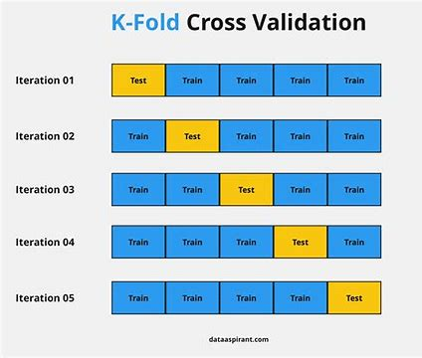
Model Improvement: K-Fold Cross-Validation
To reduce overfitting, K-Fold Cross-Validation splits the data into k groups (here, k=5) and uses them for training and testing in different subsets.
Pandian, S. (2024, June 13). K-Fold Cross Validation Technique and its Essentials. Retrieved from Analytics Vidhya.
31
Notes:
Another potential improvement to the modeling technique is using K-Fold Cross-Validation. This method splits the data into k groups (here, k=5) and uses each group as a testing set while the remaining groups are used for training. By averaging the results from each fold, K-Fold Cross-Validation provides a more reliable estimate of the model's performance on unseen data. This approach prevents overfitting, promotes generalization, and ensures efficient use of data, making the model more robust to variations. Additionally, it aids in hyperparameter tuning and offers more accurate performance metrics. While it requires more processing time, the benefits of improved reliability and robustness often justify the extra computational cost.

Slide 32
Conclusion:
Models can be built using Scope 3 emissions and corporate financial data but more improvements are needed to be able to model future data accurately
Improve outlier imputation rather than dropping data
Feature reduction-Concentrate on important factors
Feature engineering
Explore Non-Linear models
32
Notes:
Page 31
The presentation has shown that models can be built using Scope 3 emissions and corporate financial data, but further improvements are necessary for more accurate future data modeling. Key areas for enhancement include:
Improving Outlier Imputation: Instead of dropping data points with extreme values, more sophisticated imputation methods could be employed. Techniques such as mean/mode substitution, regression imputation, or using algorithms like K-nearest neighbors can help retain valuable information while minimizing the impact of outliers on the model's performance.
Feature Reduction: Concentrating on the most influential factors can enhance model performance by reducing complexity and noise. Methods like recursive feature elimination, principal component analysis (PCA), or using model-based feature selection can help identify and retain the most significant variables, improving the model's predictive power and generalization to new data.
Feature Engineering: Creating new features from the existing data can reveal hidden patterns and improve model accuracy. Techniques such as polynomial features, interaction terms, and domain-specific transformations can provide more informative input to the model, capturing relationships that might be missed by the original features.
Exploring Non-Linear Models: Given the complexity of environmental and financial data, non-linear models like support vector machines (SVM), gradient boosting machines (GBM), or neural networks may provide better predictive performance. These models can capture intricate relationships between variables that linear models might miss, leading to more accurate and robust predictions.
By focusing on these areas, future models can be significantly improved, resulting in more reliable and accurate predictions for Scope 3 emissions and their relationship with corporate financial data.

